Slide 1
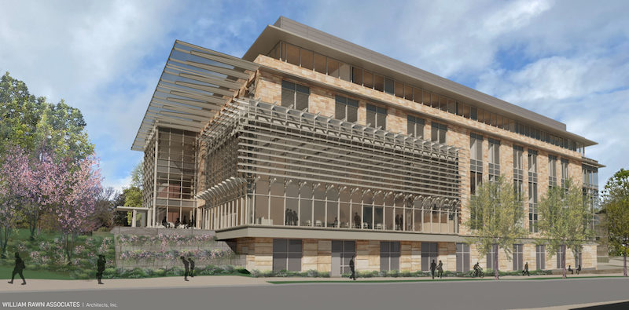
WEEK 4: SEARCH ENGINE OPTIMIZATION
Notes:
Source lesson: Week 4 Overview.html

Slide 2
WEEK 4 OVERVIEW
Search engine optimization helps people discover useful content through organic search. This week explains how search engines find and rank pages, then connects keyword research, site optimization, authority, local relevance, and content marketing.
Notes:
Source lesson: Week 4 Overview.html

Slide 3
WEEK 4 ROADMAP
SECTION 1: SEO OVERVIEW AND PILLARS
SECTION 2: ON-PAGE SEO
SECTION 3: KEYWORD RESEARCH
SECTION 4: OFF-PAGE SEO
SECTION 5: LOCAL SEO
SECTION 6: CONTENT MARKETING
Notes:
Source lesson: Week 4 Overview.html

Slide 4
SECTION 1: SEO OVERVIEW AND PILLARS
Search visibility depends on how engines discover, understand, and evaluate a page.
Notes:
Source lesson: Week 4 Section 1 SEO Overview and Pillars.html

Slide 5
SEO, SEM, AND PPC
SEO focuses on organic traffic from search engines.
SEM once described both organic and paid search, but marketers now commonly use it for paid search advertising.
PPC advertisers bid on keywords and pay when someone clicks an ad. SEO and paid search can support the same marketing goal.
Notes:
Source lesson: Week 4 Section 1 SEO Overview and Pillars.html

Slide 6
HOW SEARCH ENGINES WORK
Crawling: Bots discover new and updated pages.
Indexing: Search engines store and analyze page content, keywords, and structure.
Ranking: Algorithms select relevant pages for a search engine results page, or SERP.
Notes:
Source lesson: Week 4 Section 1 SEO Overview and Pillars.html

Slide 7
THE PILLARS OF SEO
On-page SEO improves content and page elements.
Off-page SEO builds authority through signals beyond the site.
Technical SEO helps engines access and understand the site.
Ranking also reflects meaning, relevance, quality, usability, and context.
Notes:
Source lesson: Week 4 Section 1 SEO Overview and Pillars.html

Slide 8
SECTION 2: ON-PAGE SEO
Marketers can directly improve the content, structure, and page experience that users and search engines encounter.
Notes:
Source lesson: Week 4 Section 2 On-Page SEO.html

Slide 9
CONTENT OPTIMIZATION
Useful content satisfies a need or answers a question.
Match the page to search intent: informational, navigational, transactional, or commercial.
Use headings, short paragraphs, visuals, and bullets to make information easier to scan.
Notes:
Source lesson: Week 4 Section 2 On-Page SEO.html

Slide 10
CREDIBILITY AND FRESHNESS
E-E-A-T reflects experience, expertise, authoritativeness, and trustworthiness.
Show author credentials, cite reputable sources, and publish original work.
Refresh old statistics, expand thin sections, and repair outdated links.
Notes:
Source lesson: Week 4 Section 2 On-Page SEO.html

Slide 11
HTML AND ON-PAGE ELEMENTS
Optimize the title tag, meta description, headings, schema, image alt text, and URL slug.
Use descriptive anchor text and repair broken links.
Keep text large enough to read and maintain strong color contrast. Avoid keyword stuffing.
Notes:
Source lesson: Week 4 Section 2 On-Page SEO.html

Slide 12
SECTION 3: KEYWORD RESEARCH
Keyword research turns audience language and search behavior into a focused content plan.
Notes:
Source lesson: Week 4 Section 3 Keyword Research.html

Slide 13
A KEYWORD RESEARCH PROCESS
1. Start with a focused seed keyword.
2. Review related terms and questions.
3. Compare the metrics.
4. Group keywords by topic and intent.
5. Select a manageable set that fits the audience and goal.
Notes:
Source lesson: Week 4 Section 3 Keyword Research.html

Slide 14
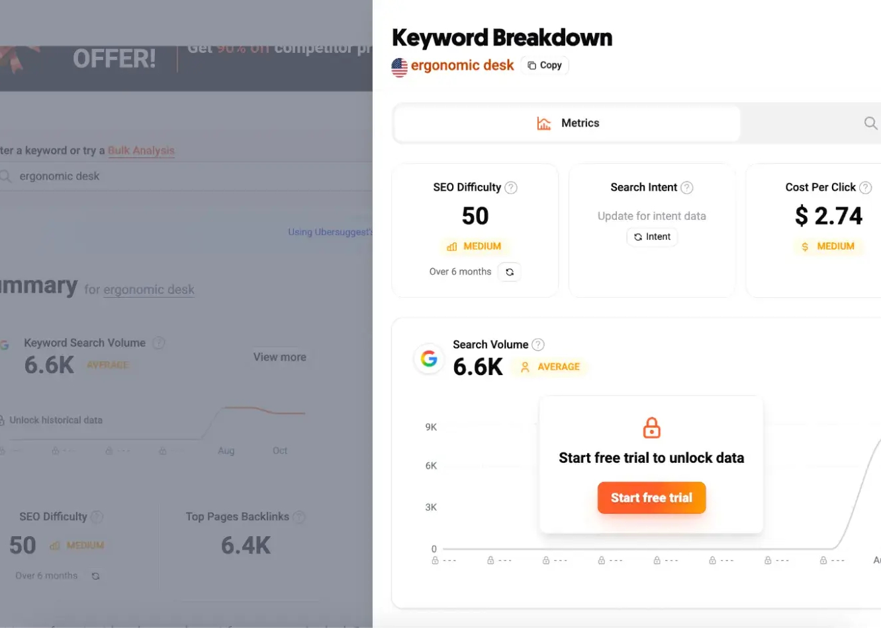
KEYWORD METRICS
Volume estimates search demand.
Difficulty shows ranking competition.
Cost per click suggests commercial value.
Intent explains the searcher's goal.
Notes:
Source lesson: Week 4 Section 3 Keyword Research.html

Slide 15
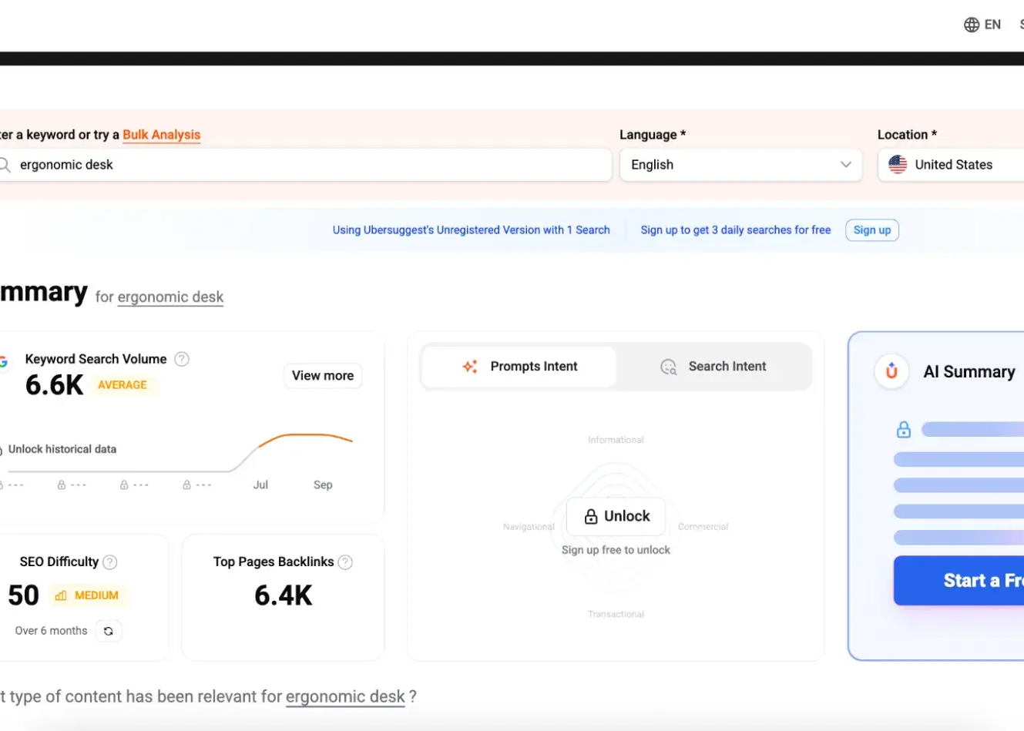
KEYWORDS ACROSS THE FUNNEL
Top of funnel: Ideas, definitions, trends, and exploratory questions.
Middle of funnel: How-to searches, strategies, templates, and workflows.
Bottom of funnel: Comparisons, reviews, pricing, alternatives, and service pages.
Notes:
Source lesson: Week 4 Section 3 Keyword Research.html

Slide 16
SECTION 4: OFF-PAGE SEO
Signals beyond the website can strengthen authority, credibility, trust, and visibility.
Notes:
Source lesson: Week 4 Section 4 Off-Page SEO.html

Slide 17
LINK BUILDING
Prioritize relevant backlinks from reputable sites. A strong endorsement can carry more value than many weak links.
Create useful, evergreen resources that continue attracting links.
Use competitor research to identify realistic link opportunities.
Notes:
Source lesson: Week 4 Section 4 Off-Page SEO.html

Slide 18
AUTHORITY BEYOND THE WEBSITE
Build credibility through expert contributions, digital PR, and credible brand mentions.
Encourage reviews and maintain accurate listings.
Social engagement can expand reach and increase the chance that useful content earns links and citations.
Notes:
Source lesson: Week 4 Section 4 Off-Page SEO.html

Slide 19
SECTION 5: LOCAL SEO
Local search connects a business with people who need a nearby product, service, or location.
Notes:
Source lesson: Week 4 Section 5 Local SEO.html

Slide 20
LOCAL SEARCH SIGNALS
Keep the business name, address, and phone number accurate and consistent.
Optimize the Google Business Profile and relevant directory listings.
Use local business schema, location language, reviews, and clear contact information.
Notes:
Source lesson: Week 4 Section 5 Local SEO.html

Slide 21
LOCATION PAGES AND AUDIENCE
Give each physical location a unique page with local content, its NAP information, and relevant testimonials.
Use clear location URLs and a useful store locator when needed.
Local, national, and international businesses require different geographic targeting.
Notes:
Source lesson: Week 4 Section 5 Local SEO.html

Slide 22
SECTION 6: CONTENT MARKETING
Content marketing attracts and retains an audience by delivering useful information before asking for a sale.
Notes:
Source lesson: Week 4 Section 6 Content Marketing.html

Slide 23
FOUR FORMS OF CONTENT
Written: Newsletters, articles, and blogs.
Audio: Podcasts, audiograms, and voice experiences.
Video: Hosted video, social video, demos, and advertising units.
Image: Social graphics, infographics, and website banners.
Notes:
Source lesson: Week 4 Section 6 Content Marketing.html

Slide 24
CONTENT TYPES AND CHANNELS
Blogs support search visibility and education. Video demonstrates products and tells stories. Podcasts build trust with niche audiences.
Social media supports conversation and distribution. Infographics simplify data. Interactive tools invite participation and can generate leads.
Notes:
Source lesson: Week 4 Section 6 Content Marketing.html

Slide 25
CONTENT MARKETING STRATEGY
Define the audience and map content to awareness, consideration, and decision stages.
Choose formats that match audience habits and campaign goals.
Distribute through owned, earned, and paid channels. Track relevant KPIs and refine the plan.
Notes:
Source lesson: Week 4 Section 6 Content Marketing.html

Slide 26
KEY TAKEAWAYS
Search engines crawl, index, and rank pages.
On-page, off-page, technical, and local SEO address different visibility signals.
Keyword research balances audience intent with volume and competition.
Useful content and clear page elements improve relevance and usability.
Consistent measurement helps marketers refine SEO and content decisions.
Notes:
Source lesson: Week 4 Overview.html and Week 4 Sections 1-6

